Slide 1
Wine Classification Problem
Batch record of 6497 Red Wine & White Wine is available for exploration. The Objective is to test supervised & unsupervised machine learning models on the dataset & identify the best fit for the data
12
Wine Attributes
Decision Tree
Support Vector Machine
Feature Selection
Logistic Regression
Data Exploration
Principal Component Analysis
Probabilistic Model
Logical Model
Black Box Model

Slide 2
Input & Output Model Concept
Initial Data Exploration
Noise Elimination Inferencing
Dependent Variables
Dependent Variables
Red Wine
&
White Wine
Fixed & Volatile Acidity
Free & Total SO₂
Machine Learning Model
Chlorides & Sulphates
Density & Quality
Citric acid & pH
Alcohol & Residual Sugar
Preprocessing Standardization Feature
Importance

Slide 3
Model Result
Logistic Regression
Split
0.2
Decision Tree
Split
0.2
Kernel
SVM
98%
98%
98%
L
Accuracy
Accuracy
Accuracy
Other Metrics
Other Metrics
Other Metrics
Precision: 0.99
Recall: 0.99
Precision: 0.99
Recall: 0.98
Precision: 0.99
Recall: 0.99

Slide 4
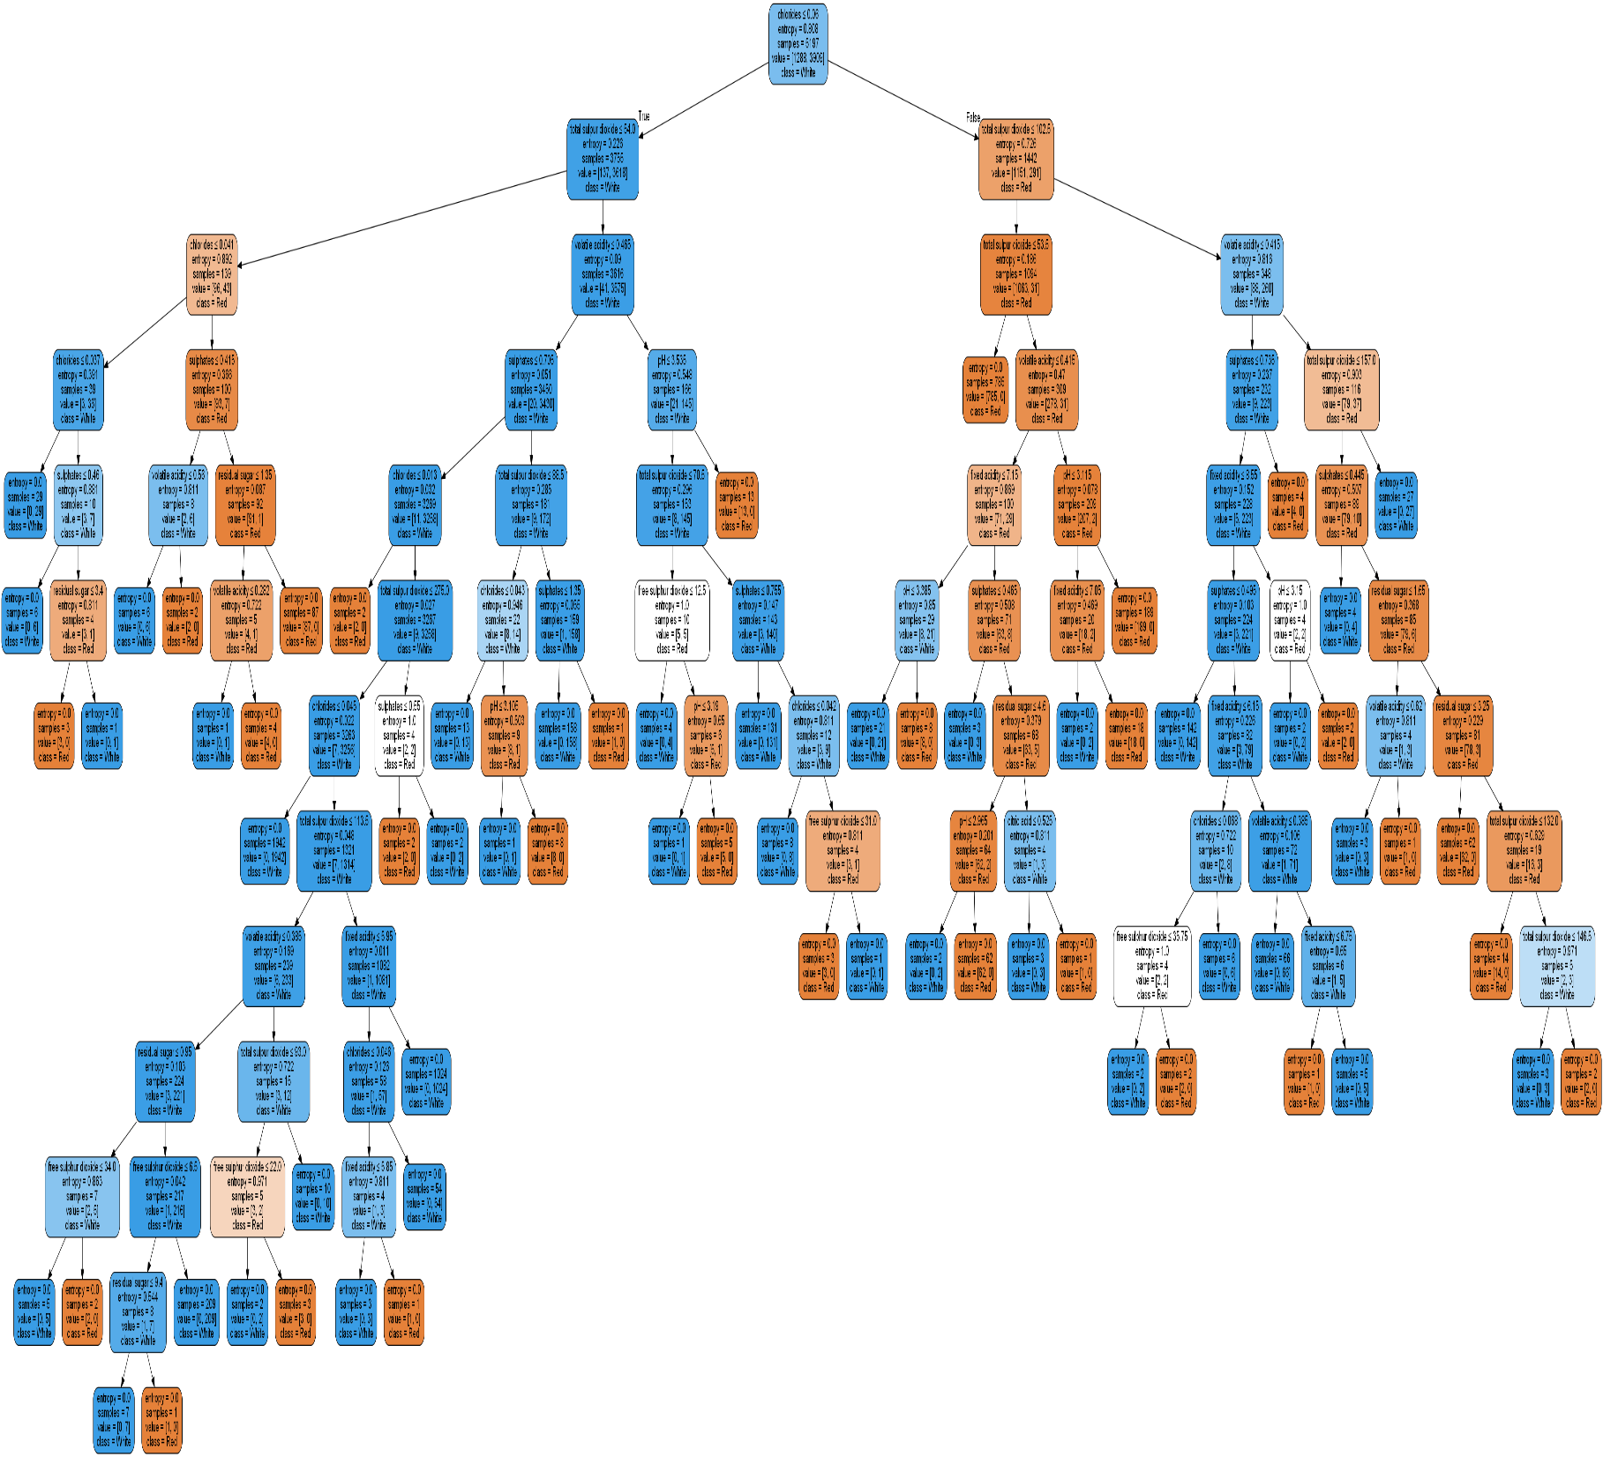
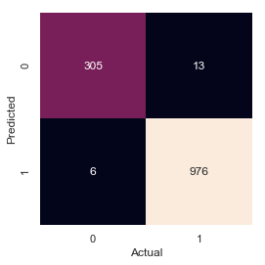
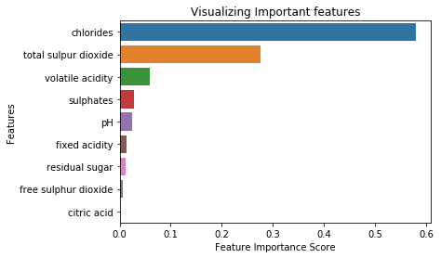
Confusion Matrix

Slide 5

Inference : For the shortest Branch of the tree
If Chloride </=0.06,
Total SO2</=54, </=88.5
Volatile acidity<=0.465,
Sulphates</=0.705, </=1.35
Then Yes the Wine is White
Low Acidity along with Chloride, SO2 & Sulphate gives White Wine
White Wines are loved for their Zesty acidity, floral aromas & pure fruit note (No Oxidation)
Min –Max
Chloride - 0.009-0.611
Total SO2 - 6-440
Volatile Acidity - 0.08-1.58
Sulphates - 0.22-2

Slide 6
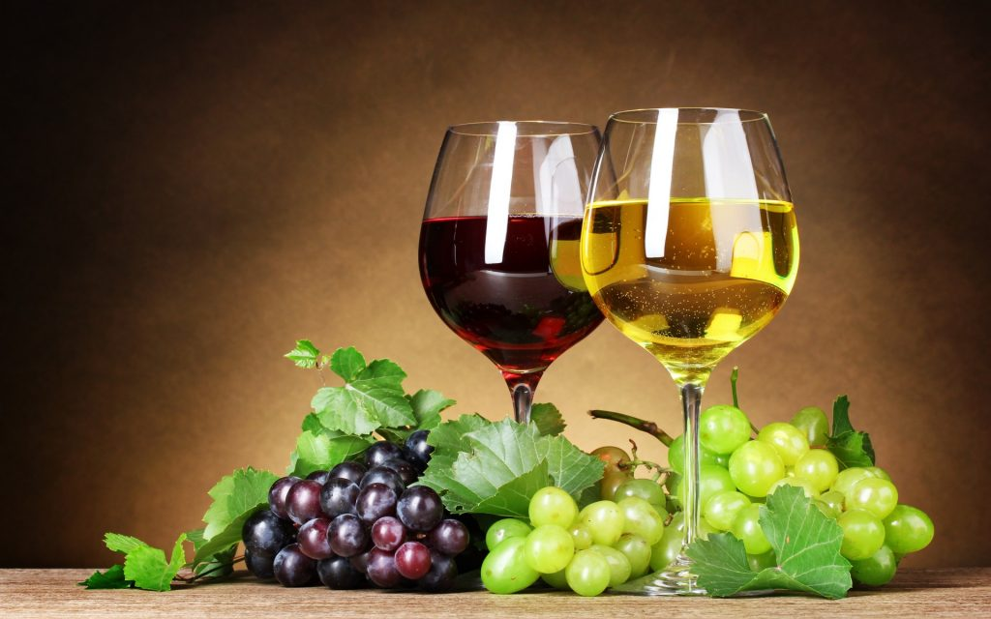
White Wine & Red Wine
White Wines are loved for their Zesty acidity,
floral aromas & pure fruit note (No Oxidation)
Red wine is made when the crushed grapes are fermented for one or two weeks in Oak barrels; whereas white wine is made when the skin and seeds of white grapes are removed and mixed with yeast and aged in stainless steel vats for fermentation.

